Slide 1
Outline
Brain network
Persistent homology
Barcode
Single linkage hierarchical clustering
Network distance
Gromov-Hausdorff distance
Bottleneck distance
Kernel distance
Notes:
My talk is divided by there parts.
First, I will start with how a brain network is constructed.
And then, I will introduce persistent homology including barcode and single linkage hierarchical clustering.
Finally, I will talk about some network distances such as Gromov-Hausdorff distance, bottleneck distance, and kernel distance.

Slide 2
Functional connectivity
if we find which parts of brain share functional properties
Structural connectivity
if we find which parts of brain are physically or anatomically connected to each other
Notes:
We will talk more about structural data and connectivity next class.
Today we will mainly use functional connectivity, especially connectivity based on PET data.
I will talk about the structural connectivity at next class.

Slide 3
Network
v₂
v₁
Network/graph
G = (V,E)
v₄
v₃
Node set
N = {v₁,v₂,…,v₇}
v₅
Edge set
E = {e₁₂,e₂₃,…,e₆₇}
v₆
v₇
Notes:
Let’s take a closer look at the brain network.

Slide 4
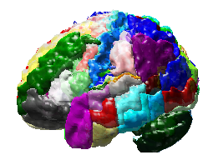
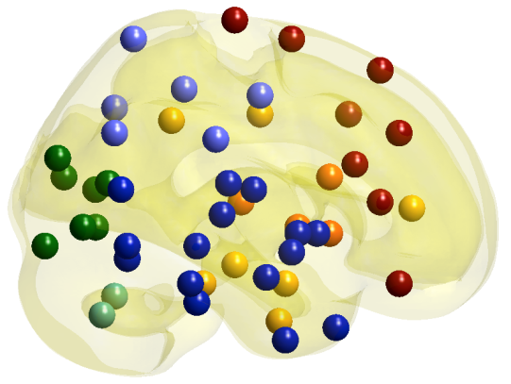
Node set
Predefined anatomical atlas
Region of interest (ROI),
90~130 ROIs
Location of a node: center of ROI
Measurement of a node: average of voxel intensities in a ROI
Notes:
So, we divide a brain into about one hundred regions according to the predefined anatomical atlas.
In this study, we used automated anatomical labeling.
Each region is called a region of interest, shortly ROI.
Then, the location of node is the center of ROI
And the measurement of a node is the average of voxel intensities in a ROI.

Slide 5
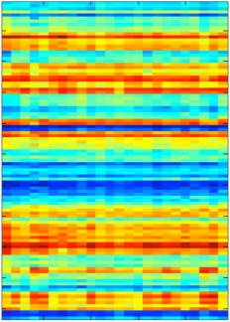
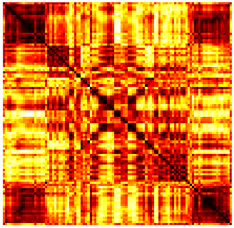
Edge weight
measurements
Data matrix
f_{i}
f_{j}
ROI
Subjects
(PET,MRI)
f_{p}
Subject
F
P
f_{i}
L
T
Distance
= sqrt(1 – corr(f_{i}, f_{j}))
S
0.787
O
f_{j}
C
O
S
R
T
Correlation
P
F
F
P
T
S
O
C
O
S
T
P
F
L
R
Distance matrix
Notes:
After estimating the measurements of node for all subjects, we can construct the data matrix like this.
Each column represents a subject and each row represents a ROI.
Then, the connection between two ROIs is estimated by correlation.
As I already said, if two measurements are
The row and column represents subject and ROIs respectively.
We define the distance between nodes as 1-correlation.
Then, we can obtain the distance matrix like this.
To easily apply persistent homology later, we change the correlation into the distance by square root of one minus correlation.
Now, this distance matrix has all information about the functional brain network.

Slide 6
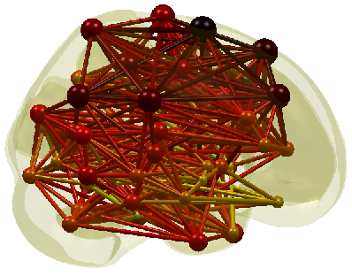
Now, network is constructed…
F
1.8
P
1.6
L
T
1.4
S
0.3
O
1.2
filtration value
C
1.0
O
0.8
S
0.6
R
T
0.4
P
0.2
F
0
F
P
T
S
O
C
O
S
T
P
F
L
R
Distance matrix
Notes:
Now, the network is constructed.
This network is a weighted network like this.
What do you want to see here?
Maybe you are wondering which parts of brain are close to each other.

Slide 7
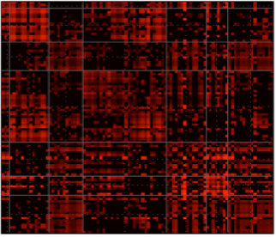
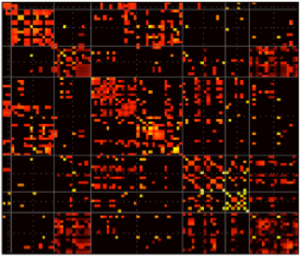
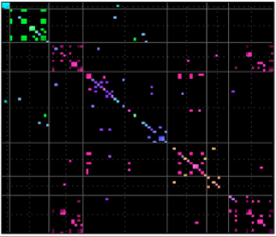
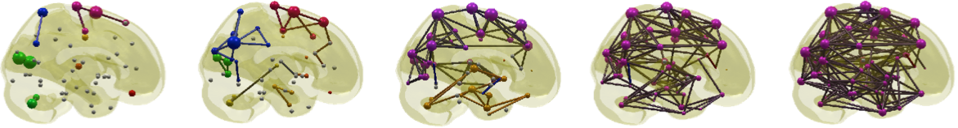
Threshold
threshold
Distance Matrix
Adjacency Matrix
Which network will you use?
Different adjacency matrices are constructed depending on the thresholds.
threshold
Notes:
So, the first thing that people did is to threshold the distance matrix and to find only the connections that are shorter than the threshold.
The thresholded matrix is called an adjacency matrix.
The entry is one if the corresponding connection has shorter distance than the threshold.
The entry of adjacency matrix is zero if the corresponding connection has longer distance than the threshold.
But, there is a problem here.
Depending on the threshold, different adjacency matrices are constructed.
Which network will we use?
There is no golden standard rule to determine the threshold.
So, we decided to observes all binary networks at all possible weights motivated by persistent homology.

Slide 8
Persistent homology
Notes:
Persistent homology is also one of topological data analysis methods.

Slide 9

Algebraic topology
Shape descriptors
Connected components
Holes
Voids
Betti number
Number of CCs, β0
Number of holes, β1
Notes:
The persistent homology is a branch of algebraic topology.
The algebraic topology deals with the shape of topological space including a network.
It also defines topological invariants that quantify the shape of topological space.
The first invariant is connected components and the second invariant is holes, and the third invariant is voids.
The number of each invariant is also importantly considered in the algebraic topology.
The number of connected components is called the zeroth Betti number.
And the number of holes is called the first Betti number.
---------------------------------------------------------------
We will extract the information of the network base on the persistent homology, a new branch of the algebraic topology.
Given the topological space, brain network is also the topological space, the algebraic topology defines the topological invariants in the algebraic form.
For example, the connected components and holes or cycles.
Especially, it counts the number of connected components and holes and called them as the zeroth and first betti numbers.
If we have the binary network or thresholded network with the given epsilon like this, we have two connected components and there is no hole in this example.
In this way, the existing algebraic topology finds the connected components and holes at the fixed scale or threshold.

Slide 10

from wikipedia
 | Coffee mug | Doughnut
Number of CCs, β0 | 1 | 1
Number of holes, β1 | 1 | 1
Notes:
There are two topological spaces here.
One is a coffee mug. The other is a doughnut.
The coffee mug has one connected component and one hole.
The doughnut also has one connected component and one hole.
So, they have the same shape in the view of topologist.

Slide 11
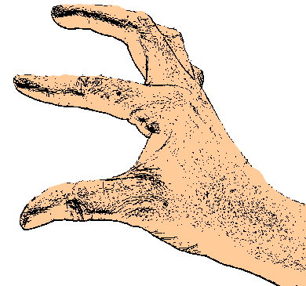
Binary network
Two nodes are connected, if the distance between the nodes is less than the given threshold, ε.
1.2
1.3
1.8
2.0
1.4
1.0
1.2
Threshold at 1.2
Threshold at 1.8

Slide 12
Thresholding
1.2
1.3
1.8
2.0
1.4
1.0
1.2
Threshold at 1.2
Threshold at 1.8
# connected components β0
# holes β1
30
11
Notes:
But, when the topological space is a binary network, the Betti number depends on the threshold.
For example, given the weighted network, if the threshold is 1.2, the binary network is constructed by connecting this, this and this edges.
Then, the zeroth Betti number is 3 and the first Betti number is zero.
If the threshold is 1.8, the binary network is constructed like this.
Then, the zeroth and first Betti numbers are one.
In this way, the Betti number is changed depending on the threshold.
So, the persistent homology proposed a method to solve this problem.
--------------------------------------------------
We will extract the information of the network base on the persistent homology, a new branch of the algebraic topology.
Given the topological space, brain network is also the topological space, the algebraic topology defines the topological invariants in the algebraic form.
For example, the connected components and holes or cycles.
Especially, it counts the number of connected components and holes and called them as the zeroth and first betti numbers.
If we have the binary network or thresholded network with the given epsilon like this, we have two connected components and there is no hole in this example.
In this way, the existing algebraic topology finds the connected components and holes at the fixed scale or threshold.
We will extract the information of the network base on the persistent homology, a new branch of the algebraic topology.
Given the topological space, brain network is also the topological space, the algebraic topology defines the topological invariants in the algebraic form.
For example, the connected components and holes or cycles.
Especially, it counts the number of connected components and holes and called them as the zeroth and first betti numbers.
If we have the binary network or thresholded network with the given epsilon like this, we have two connected components and there is no hole in this example.
In this way, the existing algebraic topology finds the connected components and holes at the fixed scale or threshold.

Slide 13
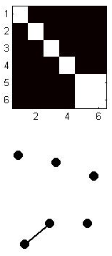
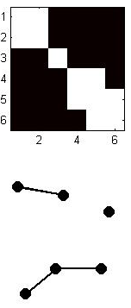
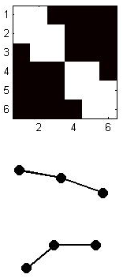
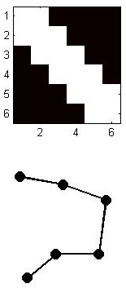
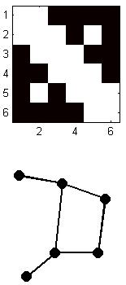
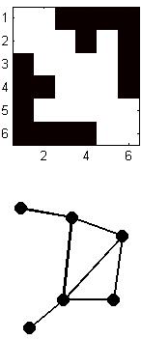
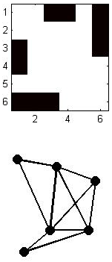
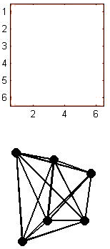
Persistent Homology
ε =1.0
ε =1.2
ε =1.3
ε =1.4
ε =1.8
ε =2.0
ε =2.5
ε =3.0
β₀ = 5
β₀ = 3
β₀ = 2
β₀ = 1
β₀ = 1
β₀ = 1
β₀ = 1
ε
β₀ = 1
β₁ = 0
β₁ = 0
β₁ = 0
β₁ = 0
β₁ = 1
β₁ = 2
β₁ = 5
β₀ = 10
Filtration
Notes:
By observing the sequence of binary networks at all possible thresholds.
And we observe the change of the Betti numbers by varying the threshold.
This procedure is called a filtration.
-----------------------------------------
But the persistent homology look at the changes of such topological invariants when the threshold or scale is varied.
This procedure is called as the filtration.
During the filtration, the number of connected components and holes are counted and it is visualized by barcode.

Slide 14
Barcode
ε =1.0
ε =1.2
ε =1.3
ε =1.4
ε =1.8
ε =2.0
ε =2.5
ε =3.0
# Connected Components
β₀ = 6
β₀ = 5
β₀ = 3
β₀ = 2
β₀ = 1
6
5
β0-curve
4
3
2
1
0
1.0
1.25
1.5
1.75
2.0
ε
Notes:
The persistent homology also provides a tool for visualizing the change of Betti numbers, called barcode.
The horizontal axis of barcode is the threshold.
And the vertical axis of barcode is the index of a connected component.
Each connected component is represented by bar.
When the threshold is zero, there is no edge to be connected.
So, the number of connected components is equal to the number of nodes.
In this example, it is six.
So, six bars are plotted like this.
When the threshold is one, these two nodes are connected.
Then, the number of connected components is 5.
So, one bar is ended and only five bars are remained.
When the threshold is one point two, two edges are connected.
And the number of connected components is three.
So, two bars are ended and only three bars are remained.
Finally, all nodes are connected in one connected component and only one bar is remained.
This is a barcode.
The barcode represents the connected component as a bar.
When epsilon is equal to zero, the number of connected components is equal to one of nodes.
Whenever the edges are added by increasing the threshold, the number of connected components decreases.
The holes are generated at 1.8 and 2.0 and they never disappear during the filtration in the network.

Slide 15
Connected Components
1
2
3
5
4
6
ε =1.0
ε =1.2
ε =1.3
ε =1.4
ε =1.8
ε =2.0
ε =2.5
ε =3.0
# Connected Components
6
5
4
3
2
1
0
1.0
1.25
1.5
1.75
2.0
6
5
4
3
2
1
0
1.0
1.25
1.5
1.75
2.0
ε
Notes:
In the barcode, we can find the whole changes of the connected structure during the filtration.
In the topology, the index of node is not important. This is because the topology thinks that bending, crumpling, rotating, or stretching affects shape.
But in the brain network, the location of nodes is very important.
So, we rearrange the bars according to the location of nodes.
Then, we obtained this Dendrogram.

Slide 16
Single Linkage Dendrogram
1
2
3
5
4
ε =1.0
ε =1.2
6
ε =1.3
ε =1.4
ε =1.8
ε =2.0
ε =2.5
ε =3.0
Single Linkage Distance
Single Linkage Dendrogram
6
5
4
3
2
1
0
1.0
1.25
1.5
1.75
2.0
ε
Notes:
In this dendrogram, two connected components are connected at the minimum distance between two connected components.
For example, the connected component consisting of nodes 1, 2, and 3 and the connected component consisting of nodes 4, 5, and 6 are connected at the threshold 1.4.
This is the minimum distance between two connected components.
This distance is single linkage distance. So, this dendrogram is called a single linkage dendrogram.

Slide 17



FDG-PET Data
Attention deficit hyperactivity disorder (ADHD), 23 subjects
Autism spectrum disorder (ASD)
21 subjects
Pediatric control (PedCon)
10 subjects
Notes:
We applied this method to FDG-PET data set.
It consists of three groups. The first is attention deficit hyperactivity disorder.
The second is autism spectrum disorder.
The third is pediatric control.
The number of subjects is very small.
To measure PET, the radioactive material should be injected to the subject.
Children’s parents usually do not like such a thing.
So, it is quiet difficult to recruit young subjects. This number of subjects is allowed in PET study.

Slide 18
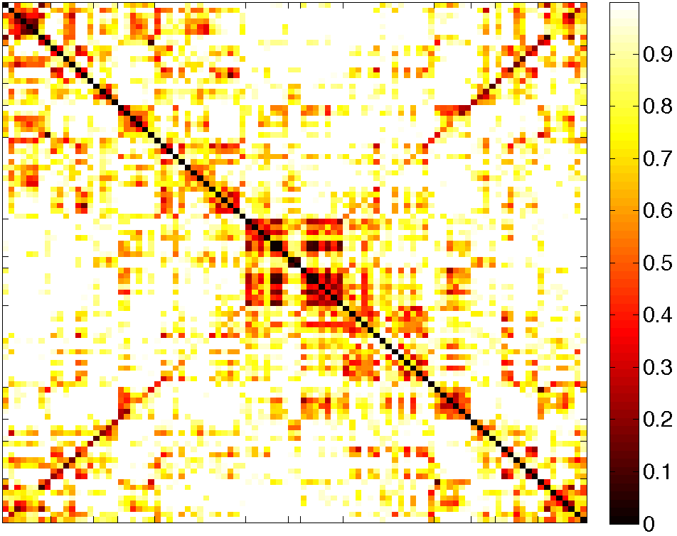
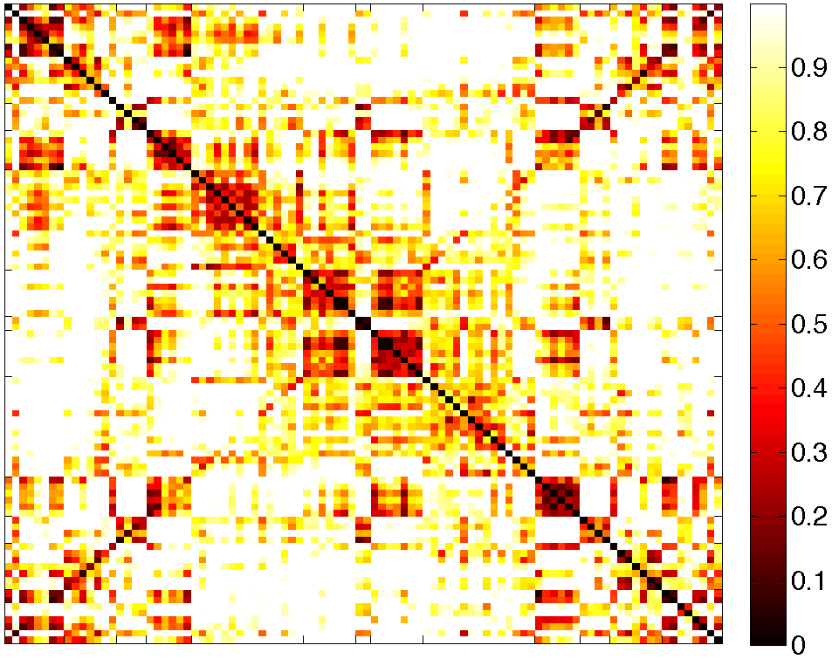
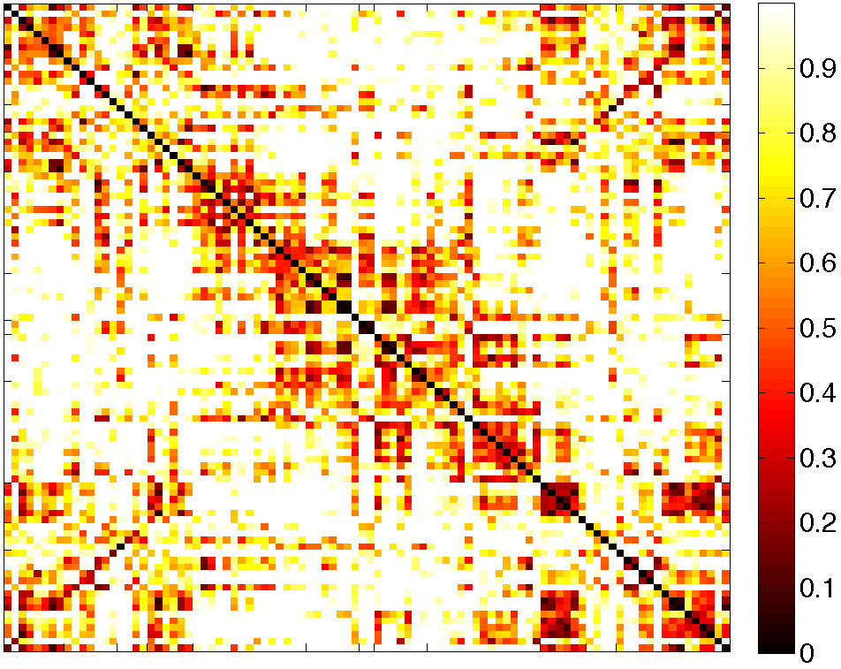
Distance matrix
F
F
F
L
L
L
S
S
S
L
P
L
P
L
P
T
T
T
O
O
O
C
C
C
O
O
O
T
T
T
R
P
R
P
R
P
S
S
L
S
L
L
L
L
L
F
F
F
F
S
P
T
O
C
O
T
P
S
L
L
F
F
S
P
T
O
C
O
T
P
S
F
S
L
L
F
P
T
O
C
O
T
P
S
L
L
F
ADHD
ASD
PedCon
R
R
R
Notes:
These are the distance matrices of three groups.

Slide 19
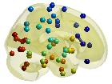
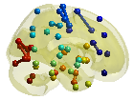
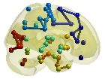
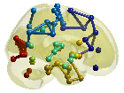
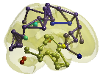
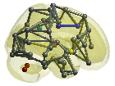
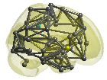
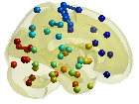
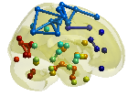
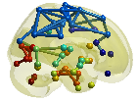
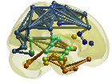
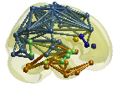
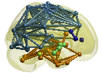
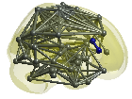
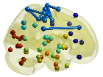
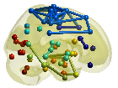
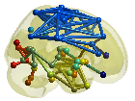
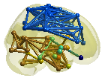
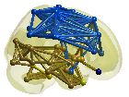
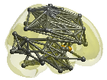
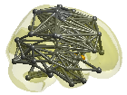
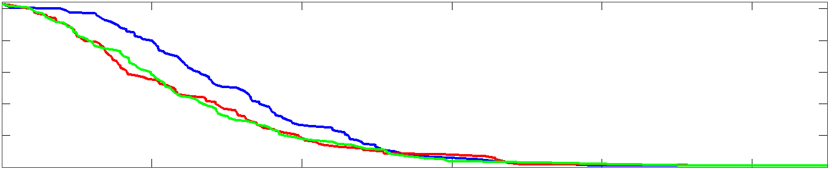

Graph filtration and its barcode β₀
ADHD
ASD
PedCon
100
ADHD, β₀
80
ASD, β₀
PedCon, β₀
60
Number of CCs β₀
40
20
0
0
0.1
0.2
0.3
0.4
0.5
Filtration value
Notes:
We perform the filtration like this. And estimate the change of number of connected components.
And visualize it by beta0 curve like this.
The blue is for ADHD, the red and green is for ASD and PedCon.
The curves of ASD and PedCon are similar, but the number of connected components of ADHD slowly decrease over the threshold.
It means that the brain regions of ADHD are slowly integrated compared to the other groups.

Slide 20
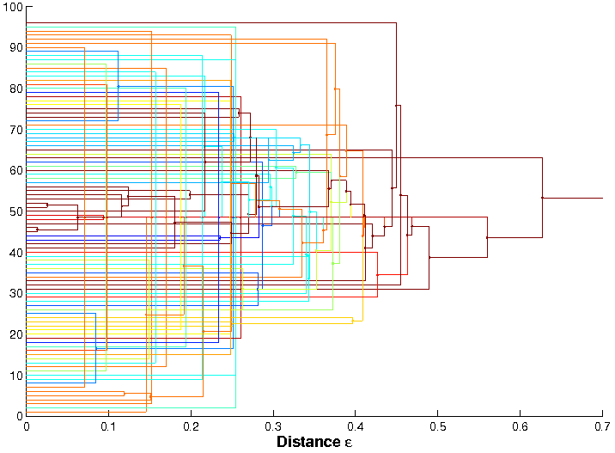
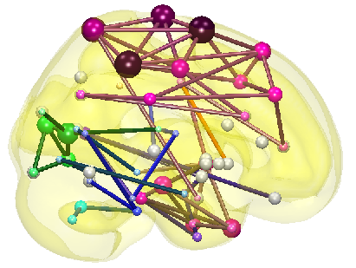
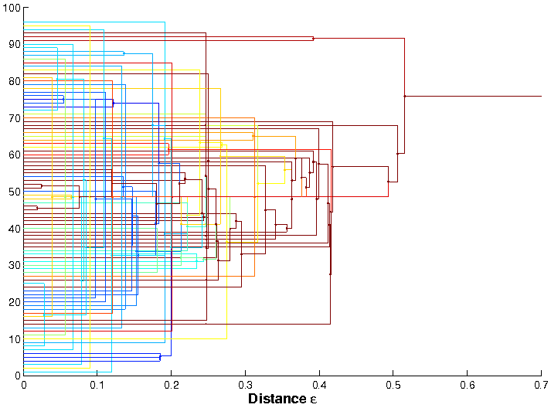
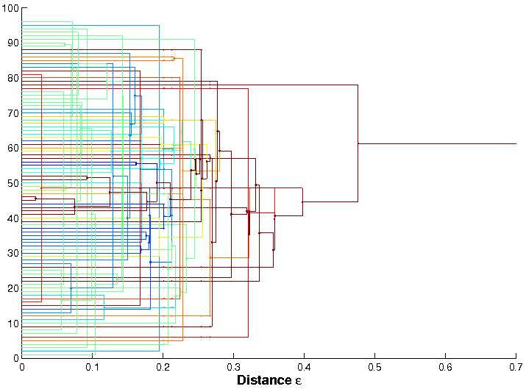
frontal
limbic
subcortical
right
parietal
ADHD
temporal
occipital
Cerebellum
occipital
temporal
left
parietal
subcortical
limbic
frontal
0 0.1 0.2 0.3 0.4 0.5 0.6 0.7
Distance ε
frontal
Distance ε
limbic
subcortical
right
parietal
ASD
temporal
occipital
Cerebellum
occipital
temporal
left
parietal
subcortical
limbic
frontal
0 0.1 0.2 0.3 0.4 0.5 0.6 0.7
Distance ε
frontal
limbic
subcortical
right
parietal
PedCon
temporal
occipital
Cerebellum
occipital
temporal
left
parietal
subcortical
limbic
frontal
0 0.1 0.2 0.3 0.4 0.5 0.6 0.7
Distance ε
Notes:
These are the single linkage dendrogram.
Can you find their differences?
Maybe not.
So, we tried to develop the other two representations for the change of connected structure during the filtration.
One is the single linkage matrix. And the other is the shape of network.

Slide 21
Single Linkage Matrix
Graph filtration
ε
x₁
x₂
1
2
1.2
1.3
x₃
3
2.6
1.8
1.4
4
1.2
5
1
Graph(X, 0)
6
x₅
x₄
Graph(X, 1.0)
Graph(X, 1.2)
Graph(X, 1.3)
Graph(X, 1.4)
Graph(X, 1.8)
x₆
x₁
x₂
x₃
x₄
x₅
x₆
x₁
x₂
x₃
x₄
x₅
x₆
x₁
x₂
x₃
x₄
x₅
x₆
x₂
x₃
x₄
x₅
x₆
ε₁= 1 2
1 ε₂= 1.2
1 1.2 ε₃= 1.3
1 1.2 ε₄= 1.4
 | x₁ | x₂ | x₃ | x₄ | x₅ | x₆
x₁ | 0 | 0 | 0 | 0 | 0 | 0
x₂ | 0 | 0 | 0 | 0 | 0 | 0
x₃ | 0 | 0 | 0 | 0 | 0 | 0
x₄ | 0 | 0 | 0 | 0 | 0 | 0
x₅ | 0 | 0 | 0 | 0 | 0 | 1
x₆ | 0 | 0 | 0 | 0 | 1 | 0
 | x₁ | x₂ | x₃ | x₄ | x₅ | x₆
x₁ | 0 | 1.2 | 0 | 0 | 0 | 0
x₂ | 1.2 | 0 | 0 | 0 | 0 | 0
x₃ | 0 | 0 | 0 | 0 | 0 | 0
x₄ | 0 | 0 | 0 | 0 | 1.2 | 1.2
x₅ | 0 | 0 | 0 | 1.2 | 0 | 1
x₆ | 0 | 0 | 0 | 1.2 | 1 | 0
 | x₁ | x₂ | x₃ | x₄ | x₅ | x₆
x₁ | 0 | 1.2 | 1.3 | 0 | 0 | 0
x₂ | 1.2 | 0 | 1.3 | 0 | 0 | 0
x₃ | 1.3 | 1.3 | 0 | 0 | 0 | 0
x₄ | 0 | 0 | 0 | 0 | 1.2 | 1.2
x₅ | 0 | 0 | 0 | 1.2 | 0 | 1
x₆ | 0 | 0 | 0 | 1.2 | 1 | 0
 | x₁ | x₂ | x₃ | x₄ | x₅ | x₆
x₁ | 0 | 1.2 | 1.3 | 1.4 | 1.4 | 1.4
x₂ | 1.2 | 0 | 1.3 | 1.4 | 1.4 | 1.4
x₃ | 1.3 | 1.3 | 0 | 1.4 | 1.4 | 1.4
x₄ | 1.4 | 1.4 | 1.4 | 0 | 1.2 | 1.2
x₅ | 1.4 | 1.4 | 1.4 | 1.2 | 0 | 1
x₆ | 1.4 | 1.4 | 1.4 | 1.2 | 1 | 0
Notes:
The single linkage matrix shows the change of connected structure in the matrix form.
The entry is the single linkage distance between two nodes.
For example, the nodes 5 and 6 are connected at the threshold 1.
So, their single linkage distance is one.
It is written here.
The nodes one and two are connected at the threshold 1.2.
So, its entry is one point two.
And the nodes five six and the nodes 4 are also connected at the threshold one point two.
So, their entries are one point two.
At the threshold 1.3, the nodes one two and nodes 3 are connected like this.
And at the threshold one point 4, the nodes 1,2,3 and the nodes 4,5,6 are connected.
So, their single linkage distance is 1.4 like this.
There is no more single linkage distance.
And this is a single linkage matrix.

Slide 22
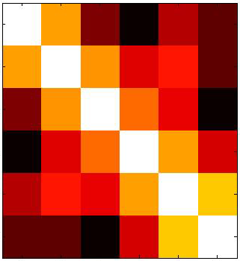
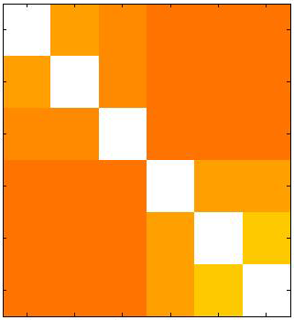
Single Linkage Matrix
Graph filtration
ε
x₁
1.2
x₂
1.3
x₃
2.6
1.8
1.4
1
1.2
Graph(X, 0)
x₅
x₄
Graph(X, 1.0)
Graph(X, 1.2)
Graph(X, 1.3)
Graph(X, 1.4)
Graph(X, 1.8)
x₆
x₁
x₂
x₃
x₄
x₅
x₆
x₁
x₂
x₃
x₄
x₅
x₆
x₁
x₂
x₃
x₄
x₅
x₆
x₂
x₃
x₄
x₅
x₆
ε₁= 1 2
1 ε₂= 1.2
1 1.2 ε₃= 1.3
1 1.2 ε₄= 1.4
x₁
0 | 1.2 | 2.5 | 3 | 2.2 | 2.6
1.2 | 0 | 1.3 | 2.1 | 1.8 | 2.6
2.5 | 1.3 | 0 | 1.4 | 2 | 3
3 | 2.1 | 1.4 | 0 | 1.2 | 2
2.2 | 1.8 | 2 | 1.2 | 0 | 1
2.6 | 2.6 | 3 | 2 | 1 | 0
x₁
0 | 1.2 | 1.3 | 1.4 | 1.4 | 1.4
1.2 | 0 | 1.3 | 1.4 | 1.4 | 1.4
1.3 | 1.3 | 0 | 1.4 | 1.4 | 1.4
1.4 | 1.4 | 1.4 | 0 | 1.2 | 1.2
1.4 | 1.4 | 1.4 | 1.2 | 0 | 1
1.4 | 1.4 | 1.4 | 1.2 | 1 | 0
x₂
x₂
Distance
matrix c_{X}
x₃
Single Linkage
matrix d_{X}
x₃
x₄
x₄
x₅
x₅
x₆
x₆
x₁
x₂
x₃
x₄
x₅
x₆
x₁
x₂
x₃
x₄
x₅
x₆
Notes:
This is the distance matrix.
It shows the pairwise distance between two nodes.
This is the single linkage matrix.
It shows when two nodes belong to the same connected component.

Slide 23
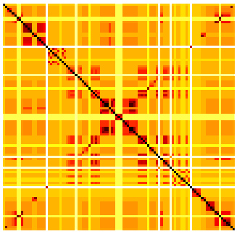


Single Linkage Matrix
ADHD
ASD
PedCon
F
P
L
T
S
O
C
O
S
R
T
P
F
F
P
T
S
O
C
O
S
T
P
F
F
P
T
S
O
C
O
S
T
P
F
F
P
T
S
O
C
O
S
T
P
F
L
R
L
R
L
R
100
ADHD, β₀
80
ASD, β₀
PedCon, β₀
60
Number of CCs β₀
40
20
0
0
0.1
0.2
0.3
0.4
0.5
Filtration value
Notes:
We this method to our dataset.
These are the single linkage matrices of ADHD, ASD, and PedCon.
The barcode shows the global change of the connected structure over the threshold.
The single linkage matrix shows the local change of the connected structure over the threshold.
You can find that ADHD and PedCon are different in the fronto-parietal connections.
And you can find that this region is slowly integrated in ASD.
-------------------------------------------
Using the barcode, we can compare the global change of connected structure of groups.
Using the single linkage matrix, we can compare the local change of groups.
ADHD v.s. PedCon : frontoparietal regions
(cognitive attentional control and sensori-motor integration)
ASD v.s. PedCon: BA44 & BA45
(behavioral symptom in ASD)

Slide 24
Shape of Network (minimum spanning tree)
Shape of network
Graph filtration
ε
x₁
1.2
x₂
1.3
x₃
2.6
1.8
1.4
1
1.2
x₅
x₄
Graph(X, 0)
Graph(X, 1.0)
Graph(X, 1.2)
Graph(X, 1.3)
Graph(X, 1.4)
Graph(X, 1.8)
x₆
x₁
x₂
x₃
x₄
x₅
x₆
x₁
x₂
x₃
x₄
x₅
x₆
x₁
x₂
x₃
x₄
x₅
x₆
x₂
x₃
x₄
x₅
x₆
ε₁= 1 2
1 ε₂= 1.2
1 1.2 ε₃= 1.3
1 1.2 ε₄= 1.4
If two nodes have been already connected directly or indirectly, no redundant edges are allowed.
Notes:
Now, I will show the shape of network.
In the shape of network, if two nodes have been already connected directly or indirectly, no more edges are allowed.
For example, these two connected components are connected by this edge.
No more edge can not be connected between them.
We call this the shape of network. It is also the minimum spanning tree of the original network.

Slide 25









ADHD
anterior
Left View
Right View
Horizontal View
ASD
anterior
Left View
Right View
Horizontal View
PedCon
anterior
Left View
Right View
Horizontal View
Notes:
We apply this method to our dataset.
This is the shape of network of ADHD, ASD, and PedCon.
You can easily find the disconnection between frontal and parietal regions in ADHD and ASD.

Slide 26
Network distance
Notes:
Until now, we feel the difference between groups by using barcode, single linkage matrix, and the minimum spanning tree.
Now, we need to quantify the difference between groups using the network distance.

Slide 27
Network distance
KS-test like distance - Statistical model O(ph)
→ Because KS-test like distance has a statistical, we can directly
estimate the significance. If there is no model, we should carry
out nonparametric techniques such as bootstrap or permutation.
Gromov-Hausdorff distance
Bottleneck distance(ph)
Kernel distance(ph)
Notes:
There are several network distances based on persistent homology.
Except for the Gromov-Hausdorff distance, KS-test like distance, Bottleneck distance and kernel distance are the network distances based on persistent homology.
KS-test like distance was developed by Prof. Moo Chung.
This is the distance defined on the beta0-curve of connected components.
It works very well when the beta0-curves are different.
The biggest advantage of KS-test like distance is that it has the statistical model and we can estimate the significance of distance directly.
The other distances don’t have the statistical model. So, if we want to know the significance of the result, we should do permutation or bootstrap.
It takes a very long time.
The KS-test like distance would be much better to learn directly from Prof. Moo Chung.
Here, I will talk about bottleneck distance and kernel distance.
To understand these two distances, we need to know simplicial complex, hole, persistence and persistence diagram.
So, I will explain them first.

Slide 28
Network distance
KS-test like distance
Gromov-Hausdorff distance
Bottleneck distance
Kernel distance
Beta0-curve of CC
Simplicial complex
Hole
Persistence
Persistence diagram
Notes:
There are several network distances based on persistent homology.
Except for the Gromov-Hausdorff distance, KS-test like distance, Bottleneck distance and kernel distance are the network distances based on persistent homology.
KS-test like distance was developed by Prof. Moo Chung.
This is the distance defined on the beta0-curve of connected components.
It works very well when the beta0-curves are different.
The biggest advantage of KS-test like distance is that it has the statistical model and we can estimate the significance of distance directly.
The other distances don’t have the statistical model. So, if we want to know the significance of the result, we should do permutation or bootstrap.
It takes a very long time.
The KS-test like distance would be much better to learn directly from Prof. Moo Chung.
Here, I will talk about bottleneck distance and kernel distance.
To understand these two distances, we need to know simplicial complex, hole, persistence and persistence diagram.
So, I will explain them first.

Slide 29



Simplicial complex
node
edge
filled-in
triangle
network
complex
Notes:
As you know, the nodes and edges are a building block of a network.
The algebraic topology introduce a new building block, filled-in triangle.
If we add this filled-in triangles to this network, then, you can see the hole of doughnut more clearly.
This is called simplicial complex, especially clique complex.
But for convenience, I just call it a network.

Slide 30
Hole
e₁₂
v₁
e₁₃
v₂
v₃
v₂
v₃
e₂₃
e₂₃
e₂₄
e₃₅
e₂₄
e₃₅
e₃₄
v₄
v₅
v₄
v₅
e₄₅
e₄₅
A hole is a cycle that is not filled with filled-in triangles.
that is not the boundary of filled-in triangles.
A cycle is a path that returns to itself.
Notes:
A hole is a cycle that is not filled with filled-in triangles, in other words, a cycle that is not the boundary of filled-in triangles.
A cycle is a path that returns to itself.
So, this path is a cycle in this example.
But, it is not a hole because it is filled with two filled-in triangles.
But, this example has one hole like this.

Slide 31
Persistence diagram
0
1.0
1.2
1.3
1.4
6
5
3
2
1
(0, 1.0)
(0, 1.2)
6
5
(0, 1.2)
4
(0, 1.3)
3
(0, 1.4)
2
1
0
1.0
1.2
1.3
1.4
Notes:
Then, let’s move on to the next topic, persistence diagram.
This is the barcode of this example that shows the change of connected components over the threshold.
In the barcode, each bar represents a connected component
The bar starts when the connected component appear
And the bar ends when the connected component disappear.
Now, we represent each bar by a point like this, the threshold when the bar starts comma the threshold when the bar ends.

Slide 32
0.4
0.8
1.2
1.6
2
Persistence diagram
of connected component
0
0.4
0.8
1.2
1.6
2
(0, 1.0)
(0, 1.2)
6
5
(0, 1.2)
4
(0, 1.3)
3
(0, 1.4)
2
1
0
1.0
1.2
1.3
1.4
Notes:
Then, these points can be plotted in two dimensional space like this.
This is called the persistence diagram of connected components.
In the network, all connected components are started at the threshold zero.
So, all points are on the vertical axis.
The persistence diagram is the set of points.

Slide 33
Holes
0
0
1.0
1.2
1.3
1.4
1.8
2.0
1.0
1.2
1.3
1.4
1.8
2.0
1.2
(1.8,
2.0)
1.3
1.8
2.0
0.4
0.8
1.2
1.6
Persistence diagram
of hole
1.4
2
1.0
1.2
0
0.4
0.8
1.2
1.6
2
Notes:
We can draw the persistence diagram of hole.
In this example, the hole appears at the threshold one point eight. And disappears at the threshold two by connecting this edge.
And its barcode is drawn like this and its persistence diagram is drawn like this.
The point is at 1.8 comma two.

Slide 34
1.2
0.4
0.8
1.2
1.6
2
1.3
Connected components
(CCs)
1.8
2.0
1.4
0
0.4
0.8
1.2
1.6
2
1.0
1.2
0.4
0.8
1.2
1.6
2
Holes
0
0.4
0.8
1.2
1.6
2
Notes:
In this way, a network can have two persistence diagrams. One is for connected components and the other is for holes.
They show the change of connected structure or hole structure during the filtration of a network.

Slide 35

Persistence
Distance between nodes
: Euclidean distance
How many holes does
this topological space have?
Notes:
So far, we have talked about simplicial complex, hole, and persistence diagrams.
Let's take a look at why persistent homology is persistent homology.
Suppose that we have a topological space like this.
The distance between nodes are defined by Euclidean distance between them.
Now, how many holes does this topological space have?
Maybe you can count.
It is four.

Slide 36










20
Index of holes
10
Barcode of holes
0
0.1
0.2
0.3
0.4
0.5
0.6
0.7
0.8
0.9
threshold
Notes:
Let’s check the number of holes by the filtration and the barcode of holes.
At the threshold 0.1, there are three small holes here and three bars are here.
But they disappear soon.
At the threshold 0.2, there are four holes that we might find.
There are four bars in the barcode. They last for a long duration of threshold.
The persistent homology considers such persistent holes as a signal that represents the underlying topological structure of a network.
And the other holes with short duration are considered as noise.
In the barcode, the persistence is represented by the length of bar.

Slide 37
Birth=Death
Death
persistence
Persistence diagram
of holes
Birth
20
Barcode of holes
Index of holes
10
0
0.1
0.2
0.3
0.4
0.5
0.6
0.7
0.8
0.9
threshold
Notes:
In the barcode, the persistence is the length of a bar.
In the persistence diagram, the persistence is the L-infinite distance to the diagonal line like this.
So, the farther from the diagonal line, the more persistent the hole is.

Slide 38
Birth=Death
Death
persistence
Persistence diagram
of holes
Birth
Persistent homology
Long duration of threshold
A connected component or a hole
Notes:
In the word persistent homology, the homology can represent a connected component or a hole.
The persistent means a long duration of threshold.

Slide 39

Bottleneck distance
Ref: Geometry Helps to Compare Persistence Diagrams*
Michael Kerber† Dmitriy Morozov‡ Arnur Nigmetov§
Notes:
Let’s move on to the next topic, bottleneck distance.
It is a network distance defined on persistence diagram.
Given two persistence diagrams X and Y, their bottleneck distance is defined like this.
This is L-infinite norm.
The persistence diagram is the set of points.
This small x is the point in X that represents a hole or a connected component.
x corresponds to small y in the persistence diagram Y by the function eta.
The correspondence function eta is obtained by minimizing the distance between points x and y.
This correspondence is a bijective function.
After estimating the correspondence between the points in X and the points in Y, the maximum distance between them becomes a bottleneck distance.

Slide 40


$${\left\|x−y\right\|}_{∞}=\max{(|{birth}_{x}−{birth}_{y}|,|{death}_{x}−{death}_{y}|)}$$
1. Add auxiliary points.
2. Estimate the distance between X and Y.
Death
0.5 | 5 | 6 | 5.5 | $$∞$$
4.8 | 0.5 | 1 | $$∞$$ | 1
4.8 | $$∞$$ | $$∞$$ | $$0.5$$ | $$4.8$$
$$∞$$ | 0.5 | $$∞$$ | $$5$$ | $$0.5$$
$$∞$$ | $$∞$$ | 1 | $$6$$ | $$1$$
X
Y
$$η$$
Birth
X
Y
bijection
3. Find the correspondence from X to Y
that minimizes the sum of distances
using Hungarian or Munkres assignment algorithm.
0.5
0.5
Notes:
Let’s take a closer look at bottleneck distance together.
Suppose that we have the persistence diagram X with blue points and the persistence diagram Y with red points.
First, we should estimate the bijection function.
But the number of points is different. (2개/3개)
So, we introduce auxiliary points like this.
This point corresponds to this point. So, these points belong to Y.
The distance between this and its auxiliary point is the persistence of this point.
Then, we estimate the distance between points from X to Y like this.
This point can not correspond to this point. So, we set their distance by infinity.
The distance between auxiliary points is the same as the distance between the original points.
Then, this becomes the assignment problem from X to Y that minimizes the cost or distance between two points.
So, we can use the existing algorithm such as Hungarian or Munkres algorithm.
Then, we can estimate the correspondence like this.
Their distance is like this.

Slide 41
Example

Slide 42







Gromov-Hausdorff Distance
z₄
2
10
x₁
x₂
10
2
y₂
9
x₃
10
z₂
y₁
y₃
z₃
z₁
8
x₄
5
y₅
y₄
5
12
x₅
4
z₅
(X, d_{X})
2
(Y, d_{Y})
(Z, d_{Z})
x₁
x₂
x₃
x₄
x₅
y₁
y₂
y₃
y₄
y₅
z₁
z₂
z₃
z₄
z₅
d_{X} =
x₁
0
2
10
10
10
d_{Y} =
y₁
0
2
9
9
9
d_{Z} =
z₁
0
10
10
10
12
x₂
2
0
10
10
10
y₂
2
0
9
9
9
z₂
10
0
8
10
12
x₃
10
10
0
5
5
y₃
9
9
0
5
5
z₃
10
8
0
10
12
x₄
10
10
5
0
4
y₄
9
9
5
0
2
z₄
10
10
10
0
12
x₅
10
10
5
4
0
y₅
9
9
5
2
0
z₅
12
12
12
12
0
d_{x}
d_{Y}
d_{Z}
d_{X}
d_{GH} =
0
2
8
d_{Y}
2
0
10
d_{Z}
8
10
0
Notes:
The first network distance to introduce is Gromov-Hausdorff distance.
We used here the Gromov-Hausdorff distance defined on the single linkage matrices.
There are three topological spaces here.
The first two networks are fingers. And the last one is a salad tong.
Their nodes and edge distance are given like this.
And we can estimate the single linkage matrices like this.
The original definition of GH distance is like this.
It is very complicated.
But if we know the correspondence of nodes between networks, the equation can be simplified like this.
It is just the maximum of absolute value of difference between single linkage matrices.
In the brain network, the index of nodes is fixed. So, we can use this equation.
Then, we can estimate the GH distance between networks like this.
And find that these two networks are similar, but this network is different.

Slide 43





Kernel distance
$$D_{K}\left(X,Y\right)= \left\|Φ\left(X\right)−Φ\left(Y\right)\right\|={{(Φ\left(X\right)−Φ\left(Y\right))}^{T}(Φ\left(X\right)−Φ\left(Y\right))}^{1/2}$$
$$={({Φ\left(X\right)}^{T}Φ\left(X\right)−2{Φ\left(X\right)}^{T}Φ\left(Y\right)+{Φ\left(Y\right)}^{T}Φ\left(Y\right))}^{1/2}$$
$$={(K(X,X) −2K(X,Y) +K(Y,Y))}^{1/2}$$
$$Φ(X)$$
$$Φ$$
$$X$$
Persistence state-space (PSS) kernel (Reininghaus, et. al., A Stable Multi-Scale Kernel for Topological Machine Learning)

Slide 44
Kernel distance based on PSS kernel
Notes:
This is the kernel distance.
The dark means close.
The third and fourth topological spaces are similar Because they have three holes.
The others don’t have.

Slide 45


Gromov-Hausdorff Distance
ADHD
ASD
PedCon
F
L
S
L
P
T
O
C
O
R
T
P
S
L
L
F
F
S
P
T
O
C
O
T
P
S
L
d_{X}
L
F
ADHD
ASD
PedCon
R
F
L
S
L
P
T
O
C
O
(a) GH distance
T
R
P
S
L
L
F
F
L
S
P
T
O
C
O
T
P
S
d_{X}
L
F
cluster_acc = 100 %
R
Notes:
We apply this method to our dataset.
We had three groups and three networks.
But it is difficult to compare. So, by jackknifing, we construct 23 networks in ADHD, 21 networks in ASD, and 10 networks in PedCon.
And estimate the GH distance between networks.
You can find that the GH distance within a group is small and GH distance between groups is large.
We also cluster networks based on this GH distance matrix.
The clustering accuracy was 100 %.
You may think it is something wrong.
So, we introduce more network distances for verifying the result.

Slide 46
Network distance
ADHD
ASD
PedCon
ADHD
ASD
PedCon
ADHD
ASD
PedCon
ADHD
ASD
PedCon
ADHD
ASD
PedCon
ADHD
ASD
PedCon
Gromov-Hausdorff (GH)
Bottleneck of CC (bot0)
Bottleneck of hole (bot1)
ADHD
ASD
PedCon
ADHD
ASD
PedCon
ADHD
ASD
PedCon
ADHD
ASD
PedCon
ADHD
ASD
PedCon
ADHD
ASD
PedCon
KS-test (KS)
Kernel of CC (kernel0)
Kernel of hole (kernel1)
Notes:
Then, we obtain the network distance like this.
This is the distance obtained by GH distance.
This is the distance obtained by Bottleneck distance between persistence diagram of connected components.
Remember that each network has two persistence diagrams. One is for connected components and the other is for holes.
This is the results of bottleneck distance of holes.
You can find that the connected structure of ASD is similar to the PecCon. But the hole structure is similar to ADHD.
This is the results of KS-like distance.
KS-like distance is defined on the barcode.
The results of barcode is like this. ASD and PedCon have similar barcode.
So, their KS-like distance is short.
This is the result of kernel distance of connected components and hole.
The result is similar to that of bottleneck distance.

Slide 47

Performance comparison
Ward’s Hierarchical clustering of ADHD, ASD, and PedCon
 | GH | bot0 | bot1 | ker0 | ker1
Clustering accuracy [%] | 100 | 98.2 | 88.9 | 96.3 | 98.2
Ratio of distance within a group to distance between groups
 | GH | bot0 | bot1 | ker0 | ker1
$$\frac{mean(distance within a group)}{mean(distance between groups)}$$ | 0.35 | 0.34 | 0.66 | 0.40 | 0.57
Notes:
This is the performance comparison.
The results are not quiet different.

Slide 48


















Summary
f₁
(b) FDG-PET measurements for n subjects
p
edge weight
= sqrt(1 – corr)
f₂
f_{p}
F
1.8
sub1
sub2
sub n
(g) Barcode β₀
L
P
1.6
(a) Predefined
regions of interest
T
1.4
S
0.3
O
1.2
filtration value
C
1.0
O
0.8
R
S
0.6
T
0.4
P
0.2
Rearrange bars according to
the node index.
F
F
P
T
S
O
C
O
S
T
P
F
0
0
L
R
decompose
filtration value
0.2
0.4
(c) Edge weight
matrix
F
F
0.45
P
L
P
0.4
T
0.35
T
0.3
S
0.3
O
0.25
C
O
0.2
R
S
0.15
S
T
0.1
P
0.05
O
F
F
P
T
S
O
C
O
S
T
P
F
0
(d) Adjacency matrix
(e) Connected components
L
R
C
0.2
0.4
(f) Single linkage matrix
(h) Single linkage dendrogram
Notes:
In summary, today, I explained the persistent homology and how it is applied to brain network.
The persistent homology looks at the change of the shape of network by varying the threshold.
There are several representations of the change of the shape, especially the connected structure.
The first one is the barcode, and the second one is single linkage dendrogram, signle linkage matrix and minimum spanning tree.

Slide 49
Summary
Network distance
Gromov-Hausdorff distance: single linkage matrix
Bottleneck distance: persistence diagram
Kernel distance: persistence diagram

